Slide 2
FIT 152 Fundamentals of Information Technology
Lecture 8
Topic 4: Development and deployment of IT systems

Slide 3
FIT 152: Module outcomes
Upon successful completion of this course, the student will be able to:
Demonstrate an understanding of the relationship between IT and related and informing disciplines.
Demonstrate insight in the history of computing technology, and an understanding of the Internet, and the World-Wide Web, as well as the components of an IT system and how they interrelate.
Demonstrate an understanding of complexity in an information technology environment and how and why it occurs.
Demonstrate an understanding of why life-long learning and continued professional development is critical for an IT professional.
Illustrate the use of information and communication technologies to solve problems.
Demonstrate an understanding of how and to what extent IT has changed various application domains.

Slide 4
How is the development and deployment of an IT System managed?
Read Pham2021, Chapter 10
Implementation methodologies
Direct cutover (Big-Bang deployment)
On specific date
Speedy and least expensive
Most risk
Pilot implementation
Subset of organisation
Small impact
Parallel operation
Old and new used simultaneously
Least risk
Most expensive
Phased implementation
Use different functions of new systems as old system is switched off
Slow approach

Slide 5
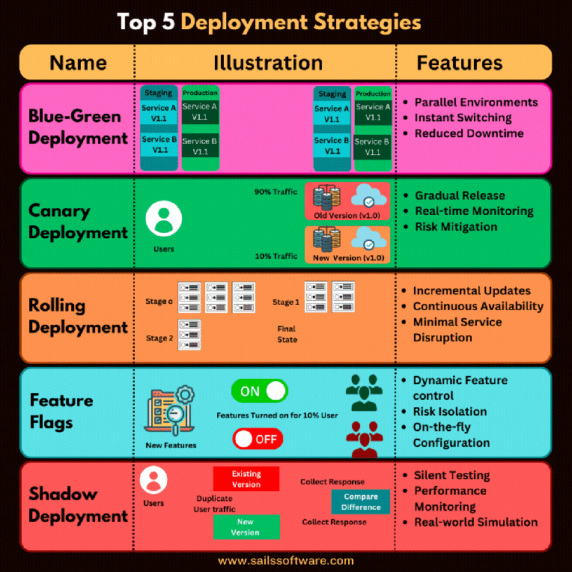
Notes:
When deploying an IT system, there are several strategies that organizations can follow depending on their specific requirements, constraints, and objectives. Here are some common deployment strategies:
1. **Big Bang Deployment**: In this approach, the entire IT system is deployed at once, replacing the existing system entirely. This strategy is suitable for small projects with minimal complexity and risk, but it can be disruptive and carry a high degree of risk if not executed properly.
2. **Phased Deployment**: Phased deployment involves rolling out the IT system in stages or phases. Each phase typically focuses on a specific subset of functionality or a particular group of users. This approach allows for incremental implementation, risk mitigation, and easier management of change. It's particularly useful for large-scale projects or systems with complex dependencies.
3. **Parallel Deployment**: Parallel deployment involves running the new IT system alongside the existing system for a certain period of time. This allows for side-by-side comparison and testing, ensuring that the new system meets the required performance standards and functionalities before fully replacing the old one. Parallel deployment can be resource-intensive but offers a lower risk of disruption.
4. **Pilot Deployment**: Pilot deployment involves implementing the IT system in a limited environment or with a small group of users before full-scale deployment. This allows organizations to gather feedback, identify potential issues, and refine the system before rolling it out to a larger audience. Pilot deployments are often used to validate assumptions, assess user acceptance, and fine-tune implementation plans.
5. **Rolling Deployment**: Rolling deployment involves gradually deploying the IT system across different segments or locations of the organization over time. This approach minimizes the impact on operations by spreading out the deployment effort and allows for quick rollback in case of any issues. Rolling deployment is suitable for systems that require continuous availability and cannot afford extended downtime.
6. **Blue-Green Deployment**: Blue-green deployment involves maintaining two identical production environments (blue and green) and switching traffic between them during deployment. The new version of the IT system is deployed to the inactive environment (green), allowing for zero-downtime deployments and easy rollback if necessary. Blue-green deployment is commonly used in cloud-based environments and for mission-critical systems.
7. **Canary Deployment**: Canary deployment involves gradually rolling out the new version of the IT system to a small subset of users or servers, while monitoring key performance metrics and user feedback. If the deployment is successful and no issues are detected, the new version is gradually rolled out to more users or servers. Canary deployment allows for early detection of issues and minimizes the impact of potential failures.
8. **Immutable Infrastructure Deployment**: Immutable infrastructure deployment involves treating infrastructure components (such as servers and containers) as immutable, meaning they are never modified after they are deployed. Instead of making changes to existing infrastructure, new instances are created with the desired configuration, tested, and then deployed. Immutable infrastructure deployment helps ensure consistency, reliability, and reproducibility of deployments.
These deployment strategies can be combined or adapted to suit the specific needs of the project and the organization. The choice of deployment strategy depends on factors such as project complexity, risk tolerance, timeline, and available resources.

Slide 6
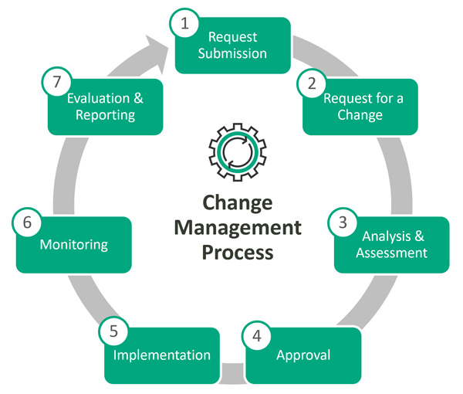
How is the development and deployment of an IT System managed?
Read Pham2021, Chapter 10
Change Management
Communication …….
Training
User acceptance
Maintenance
Fix bugs
Align system with business priorities
Policies: maintaining data, storing data

